Slide 1
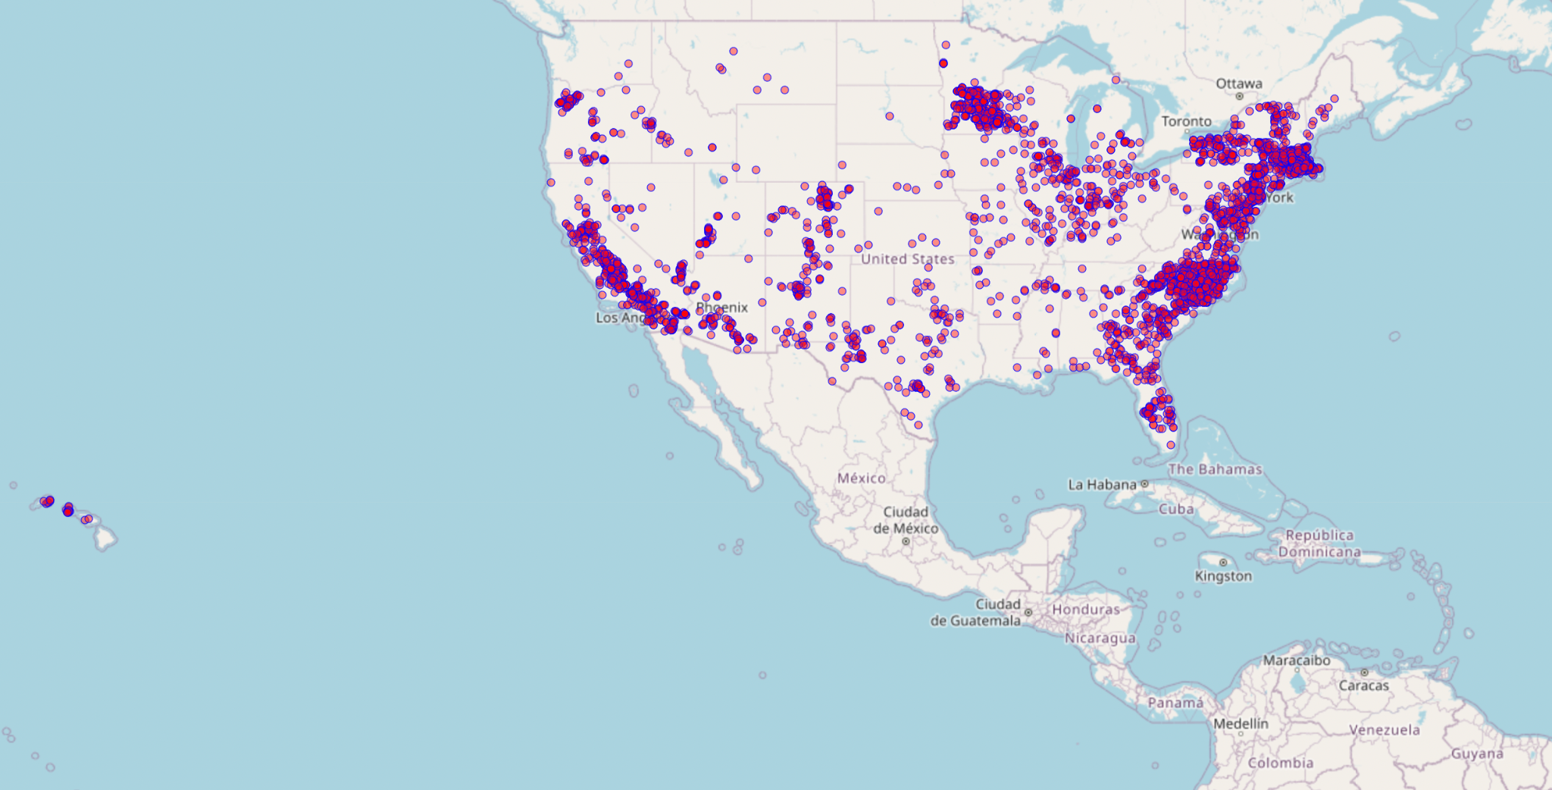
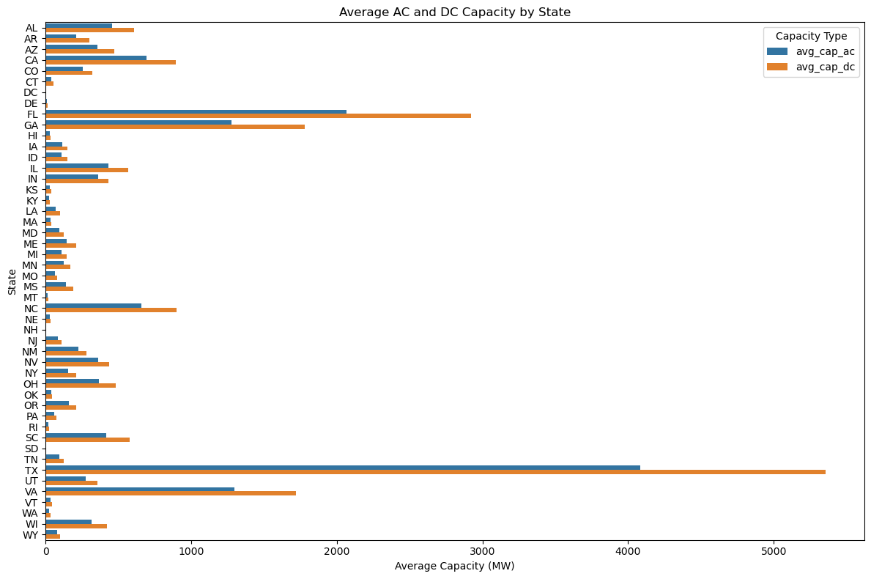
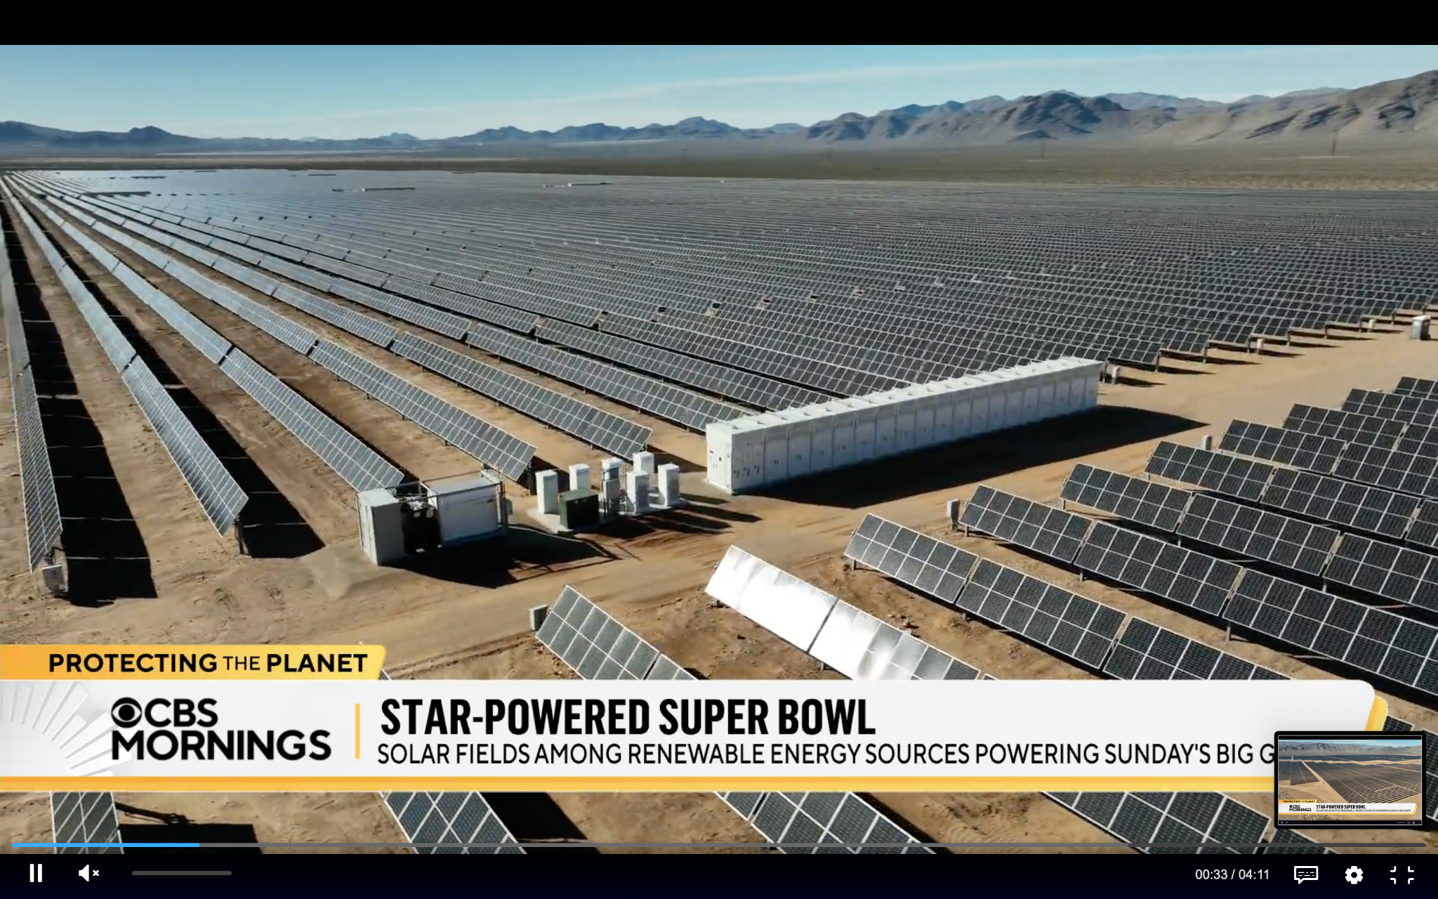
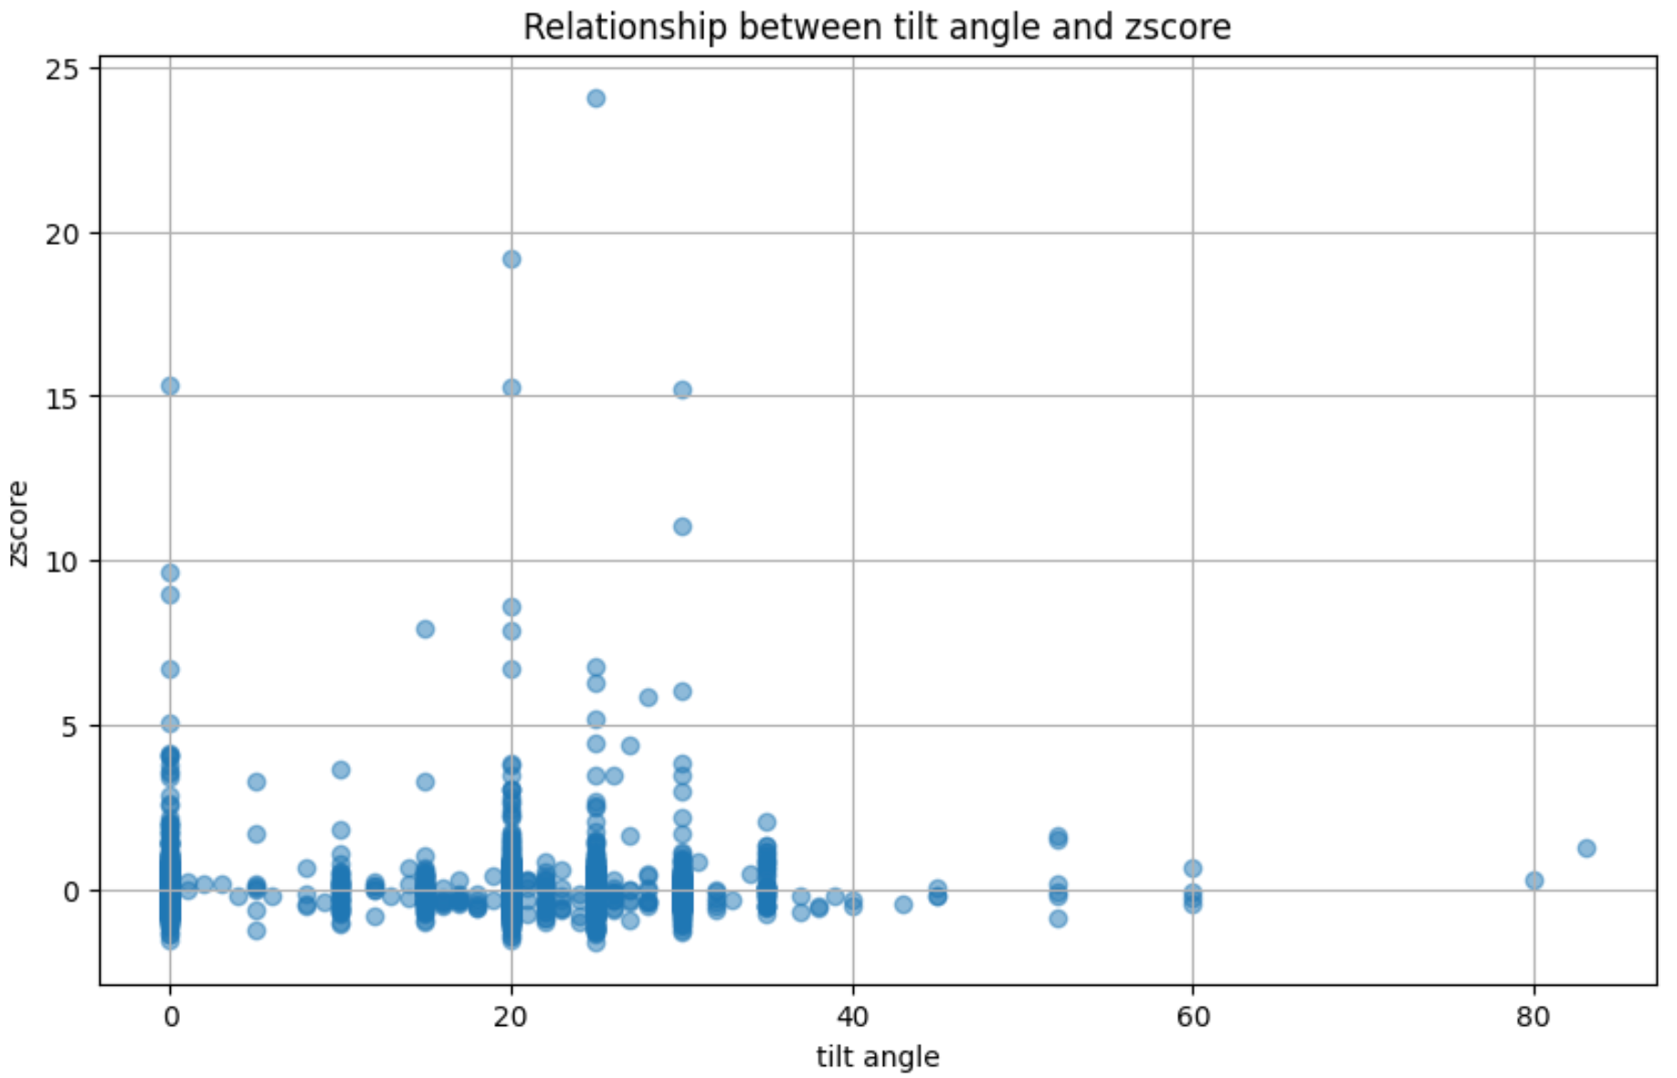
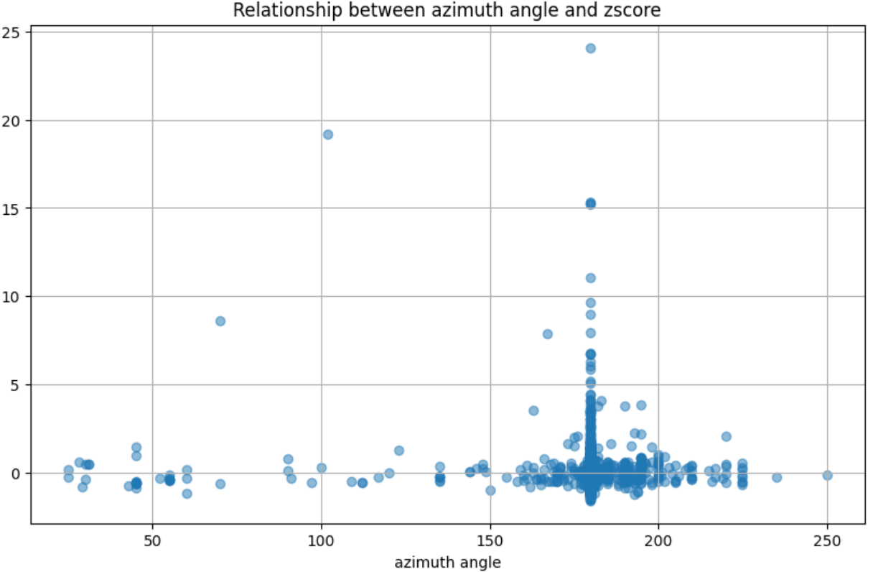
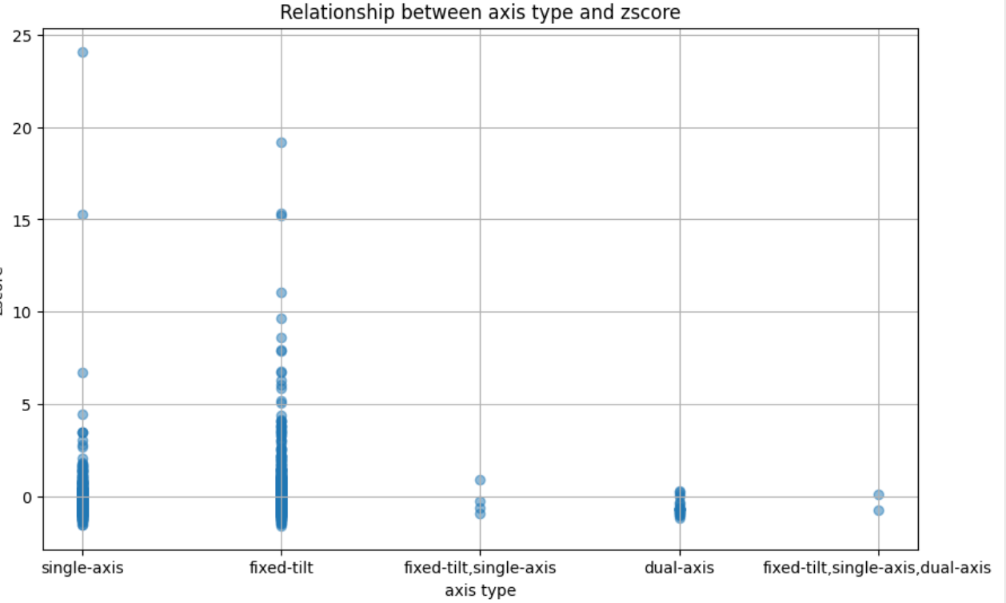
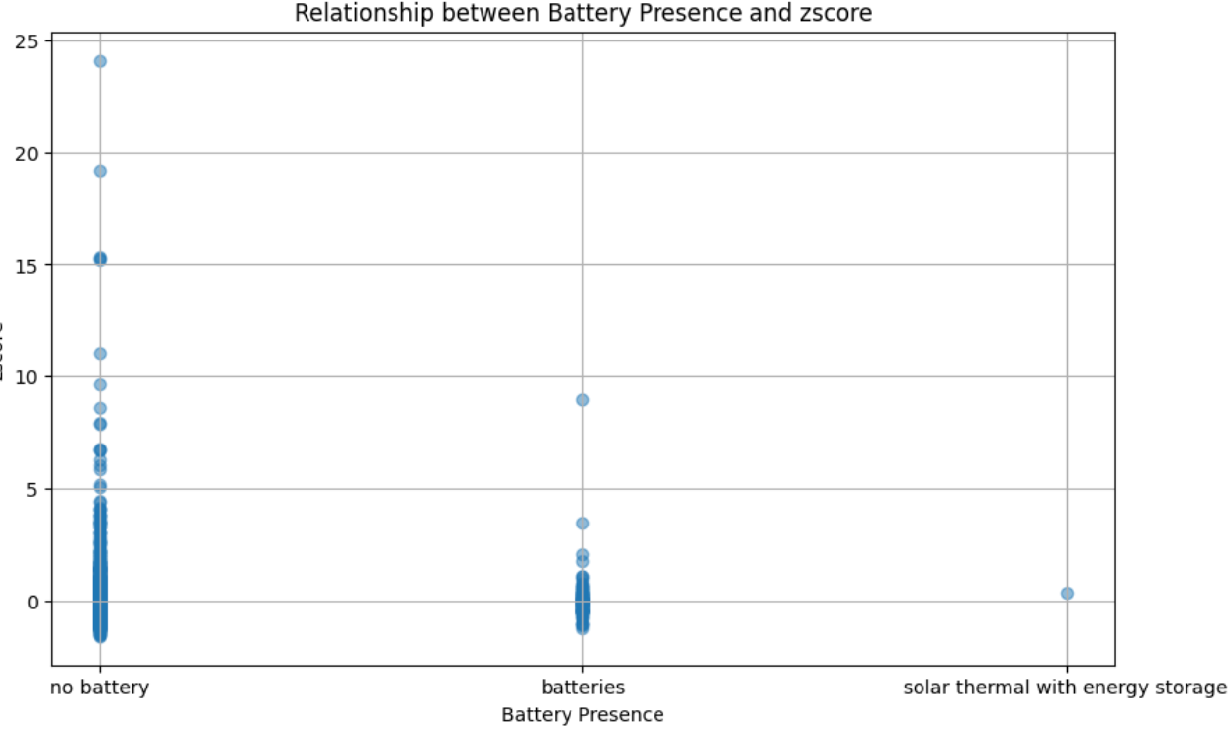
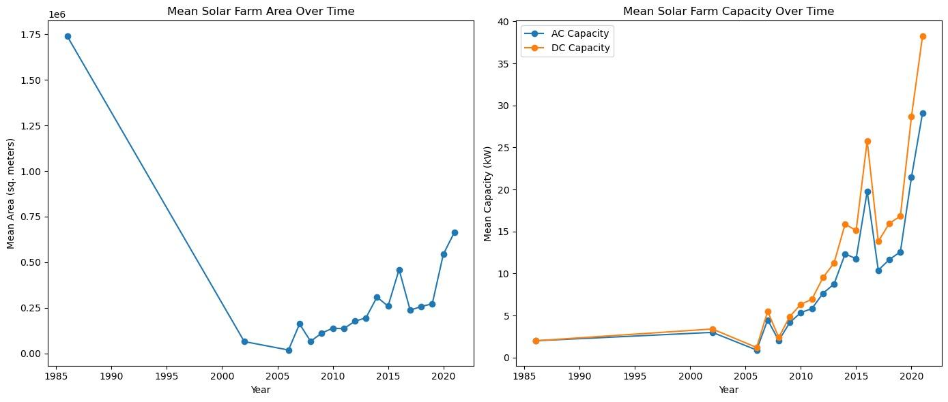
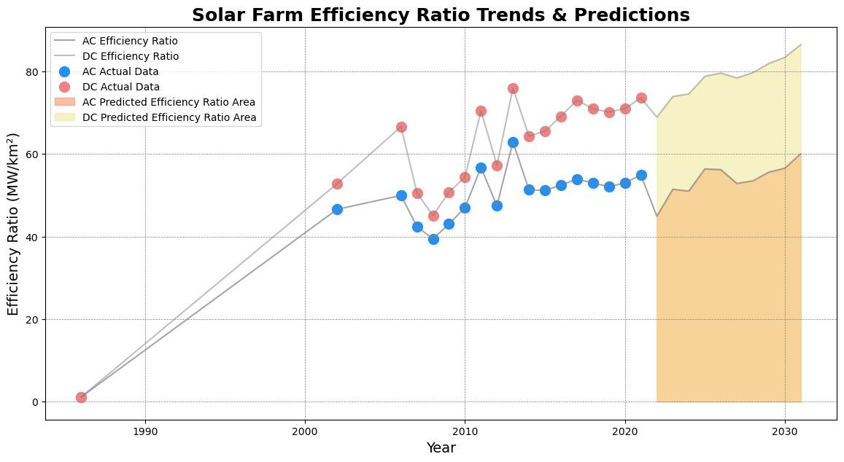
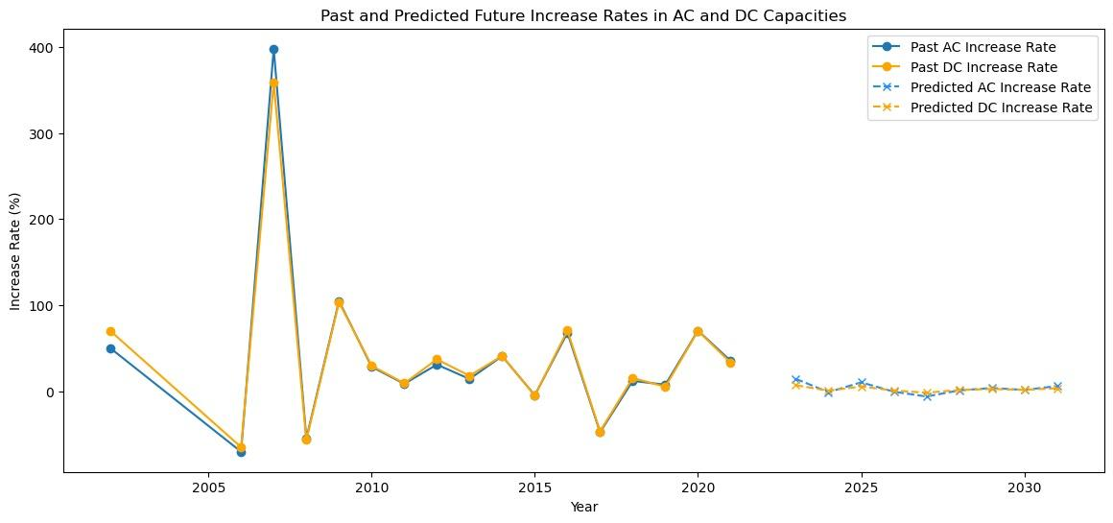
Optimizing Solar Farm Efficiency: An Analysis of Geographic, Technological, and Temporal Influences
Group member: Haohui Zheng(zhhaohui06@hotmail.com) Shentong Li(lishentong20030217@126.com)
Professor: Majed Al-Ghandour (mnalgha@ncsu.edu)
INTRODUCTION
PRODUCT & RESULT
CONCLUSION
The 2024 Super Bowl at Las Vegas' Allegiant Stadium, celebrated for being powered entirely by renewable energy, signifies a groundbreaking moment in marrying large-scale sporting events with sustainability. Drawing inspiration from this pioneering feat, our study embarks on an exploration into the broader applicability of renewable energy principles, with a special focus on solar energy's role in such achievements. We delve into the specifics of solar farm locations, highlighting the importance of geographical and environmental factors like proximity to coasts, atmospheric conditions, and supportive policy frameworks that enhance solar efficiency and development. Additionally, we scrutinize the technological nuances that contribute to the optimization of solar farms, such as panel orientation, materials, and the integration of battery storage.
Task 1. Geographic Impact on Solar Farm Efficiency
The 2024 Super Bowl's renewable energy milestone not only redefines sustainability standards for large events but also illuminates the path for wider adoption of green energy. We explore a significant impact of geographical variations on solar farm efficiency，underscoring the intricate relationship between location and solar energy generation capability. Besides, the role of supportive policies in benefiting solar energy development emerges as a critical element. The enactment of pro-solar laws supports the importance of governmental support in fostering a conducive environment for solar energy proliferation. Our analysis extends to the environmental factors affecting solar power generation, and we evaluate technical aspects such as optimal angles, axis types, panel materials, and the impact of battery storage on solar farm performance across different states. By examining tech advancements, policy frameworks, and community engagement strategies, we endeavor to pave the way for a transition to a greener future.
1.1 Geospatial Analysis
Solar farms are preferentially located near coasts (Figure 1), leveraging higher solar irradiance and cooler temperatures that enhance panel efficiency. A negative correlation between both latitude and longitude with power capacity, indicates that geographical variations significantly impact solar farm efficiency.
Supportive policies play a critical role in fostering solar energy development, influencing both the establishment and efficiency of solar farms.
1.2 Environmental Correlation
Atmospheric Pressure: Higher mean sea level pressure significantly boosts solar power generation, increasing output by approximately 176.28 kW for each unit of pressure increase.
Sun's Position: Solar power efficiency improves as the sun's zenith angle and angle of incidence decrease, indicating optimal generation when the sun is directly overhead.
Temperature: An increase in temperature 2 meters above the ground correlates with a decrease in solar power output, highlighting the negative impact of higher temperatures on panel efficiency.
Humidity: Solar power generation tends to goes up with higher relative humidity 2 meters above the ground.
Cloud Cover: Increased cloud cover at all levels significantly reduces solar power output, confirming that clouds are a barrier to sunlight reaching the panels.
Figure 1
Figure 2
FUTURE
Task 2. Technical And Design Factors
Leveraging more sophisticated geospatial analysis tools and technologies can improve the selection process for solar farm locations, ensuring optimal sunlight exposure and environmental conditions, thus maximizing energy output and efficiency.
To boost predictive model accuracy, we’ll include a wide range of data—environmental, socio-economic, technological, and policy-related. Leveraging big data, machine learning, and diverse sources like satellite imagery and IoT sensors can refine energy forecasts.
In analyzing solar farm data across different states, we found consistent trends in optimal angles, axis types, panel materials, and the impact of battery storage. For each state, there should be different outcomes, but generally, they have similar conclusions.Here are the key findings:
Optimal Angles: Best azimuth angle (Figure 3 R-up): 170-200 degrees. Best tilt angle (Figure 3 L-up): 0-30 degrees.
Axis Types (Figure 3 L-down): Preferred: single-axis and fixed-tilt. Dual-axis offers higher efficiency but may not be cost-effective.
Panel Materials: Transition to c-si for higher capacity, but thin-film remains in budget-constrained regions.
Battery Storage (Figure 3 R-down): Areas without batteries exhibit better area energy ratios, due to space limitations.
METHODOLOGY
Pandas library is used for data manipulation and preprocessing, matplotlib library enables creation of interactivity and customizable visualizations.
Spatial analysis using GeoPandas, examining solar farm distributions in United States.
Predictive model using linear regression and OLS for exploring temporal trends and investigating the impact of panel orientation.
REFERNERCE
Task 3. Predictive Model for Solar Farm Efficiency
Figure 3
https://www.cbsnews.com/news/super-bowl-2024-to-be-powered-by-nevada-desert-solar-farm/?ftag=CNM-00-10aac3a
https://www.kaggle.com/datasets/stucom/solar-energy-power-generation-dataset
Fujita, K.S., Ancona, Z.H., Kramer, L.A., Straka, M., Gautreau, T.E., Garrity, C.P., Robson, D., Diffendorfer, J.E., and Hoen, B., 2023, United States Large-Scale Solar Photovoltaic Database v1.0 (November, 2023): U.S. Geological Survey and Lawrence Berkeley National Laboratory data release, https://doi.org/10.5066/P9IA3TUS.
https://www.kaggle.com/datasets/ivnlee/solar-energy-production
https://www.kaggle.com/datasets/tunguz/country-regional-and-world-gdp
PREPROCESSING
Solar Farm Area Trends (Figure 4 up): Initiated with high areas in 1986, experienced a decrease until 2006, followed by a consistent rise with a slight dip in 2016.
Capacity Growth (Figure 4 down): Both DC and AC capacities show a continuous upward trend from 1986, with significant fluctuations in 2016 and 2018, indicating technological progress and occasional market floats.
Efficiency Ratio Trends (Figure 5): A regression algorithm is trained using historical data and factors including the year, the GDP growth(%) & annual changes, temperature. The visualization shows a steady growth in the next 10 years with a notable increas e predicted in 2026.
Past and Predicted Future Increase Rate (Figure 6): Marks a peak in 2007, attributed to rising demand catalyzing industry advancements, signifying demand-driven progress in solar technology.
Solar Photovoltaic Database
We scale the area from square meters to square kilometers.
We define the efficiency of a solar farm as the amount of electric power it can produce per unit area (MW/km²).
Environmental Database
Standardize wind speed columns and normalize cloud columns.
Handling cyclical wind direction with sine and cosine transformation
United States GDP Database
Impute the `GDP Growth(%)` and `Annual Change` using random methods.
Figure 5
Figure 4
Figure 6

